Slide 1
Strange Bedfellows: The Interplay between Cal-OSHA and Federal OSHA

Slide 2

Your Speakers: Lisa Prince and Matthew Deffebach

Slide 3

How much interplay is there between the organizations?

Slide 4

Similarities:
Inspection process.
Time to contest (appeal) and time for the agency to issue a citation.

Slide 5

Similarities- Regulations:
Powered Industrial Trucks
Exits and Emergency Planning
LOTO
PPE
Occupational Noise
Electrical
Machine Guarding
Others

Slide 6

What about Injury Reporting?
California Changes
300A Electronic Uploading?
Any differences on types of reports that will result in an investigation?

Slide 7

Differences:
The Appeal/Contest Process.

Slide 8

What is this?
California: Form 1BY –Notice of Intent to Classify as a Serious

Slide 9
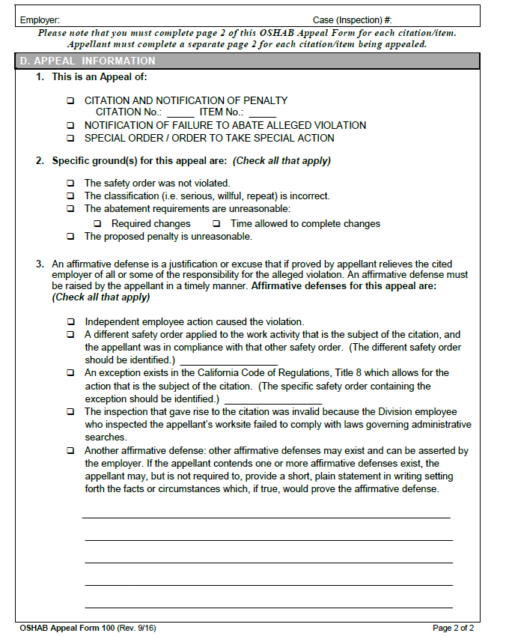

Notice of Contest v. Appeals Form
Do not send in a notice of contest in California.
Note – affirmative defenses.

Slide 10
Differences:
Expedited hearings and the pressure to abate.
What about abatement if you lose first round hearing with the judge and decide to appeal?
Classifications and fine amounts.

Slide 11

What about Repeats?
- Changes in California.
- Federal case law (Angelica Textile).

Slide 12

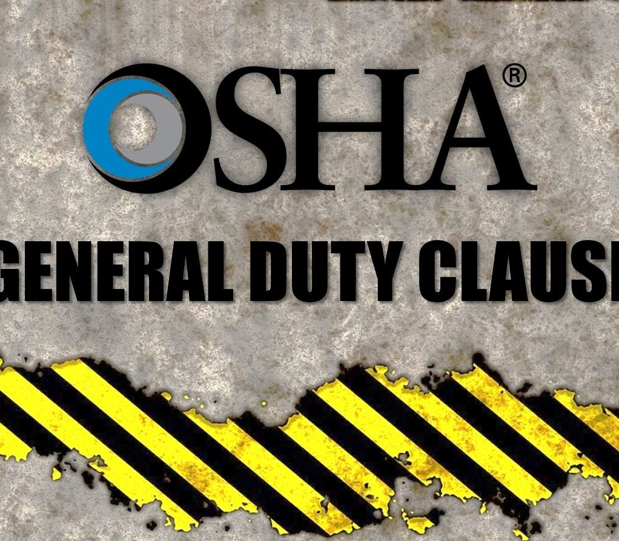
General Duty Clause v. IIPP

Slide 13
Differences in Regulations:
Wildfire Smoke
Indoor Heat
Ergonomics
Permissible Exposure Limits

Slide 14


Slide 15


Current state of COVID-19.

Slide 16

Heat
Federal:
  Not an active topic.
  A.H. Sturgill Roofing, Inc. (OSHRC Feb. 2019) – would need compelling evidence of heat being recognized hazard under General Duty Clause.
California:
  Already an outdoor heat regulation.
  Standards Board is working on an indoor heat regulation:
    Last comment on April 22, 2019: After careful review of the comments received on the draft standard posted on January 29, 2019, further revisions have been made. Cal/OSHA is preparing rulemaking documents based on this draft. No further changes prior to rulemaking are anticipated.

Slide 17
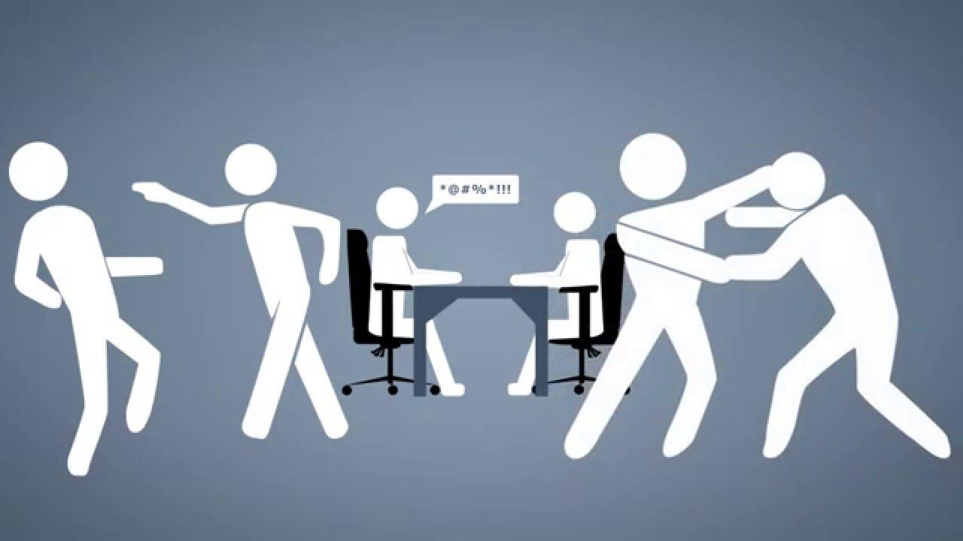
Workplace Violence
Federal:
  Integra Health Management, Inc. (OSHRC Mar. 2019) – recognized use of General Duty Clause but with very specific facts.
  Very little actual use of General Duty.
California:
  Existing standard for health care industry.
  Standards Board working on general industry, including most recent draft from October 2018 and proposed changes with new version coming.
    More Plans – hazard assessments and active shooter procedures.
    More Training.
    Violent incident log (recordkeeping).

Slide 18

Foot Protection

Slide 19
Questions?

